Slide 1


Haptic Feedback Glove
Sohan Patel and Noah Franceschini
12/6/2022

Slide 2

Agenda
Overview
Design
PCB Design
Results
Questions
ELECTRICAL AND COMPUTER ENGINEERING
GRAINGER ENGINEERING

Slide 3
Overview
ELECTRICAL AND COMPUTER ENGINEERING
GRAINGER ENGINEERING

Slide 4
Overview
Objectives
The world has become increasingly virtualized and more remote than ever before
Touch is a sense we cannot replicate without being near an object
ELECTRICAL AND COMPUTER ENGINEERING
GRAINGER ENGINEERING

Slide 5
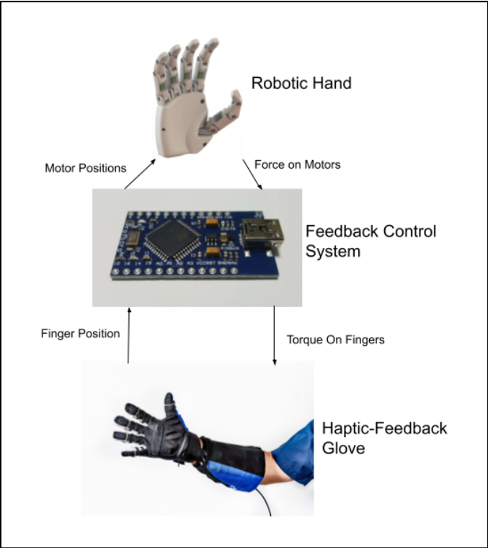
Solution
Glove reads hand position and applies forces to hand
Manipulator mimics position and measures force applied to object
IMAGE
ELECTRICAL AND COMPUTER ENGINEERING
GRAINGER ENGINEERING

Slide 6
Requirements
High Level Requirements
Low latency of less than 1s
Must provide a wide range of forces
Measure and apply forces back to user’s hand of at least 10 pounds of force
ELECTRICAL AND COMPUTER ENGINEERING
GRAINGER ENGINEERING

Slide 7
Design
ELECTRICAL AND COMPUTER ENGINEERING
GRAINGER ENGINEERING

Slide 8
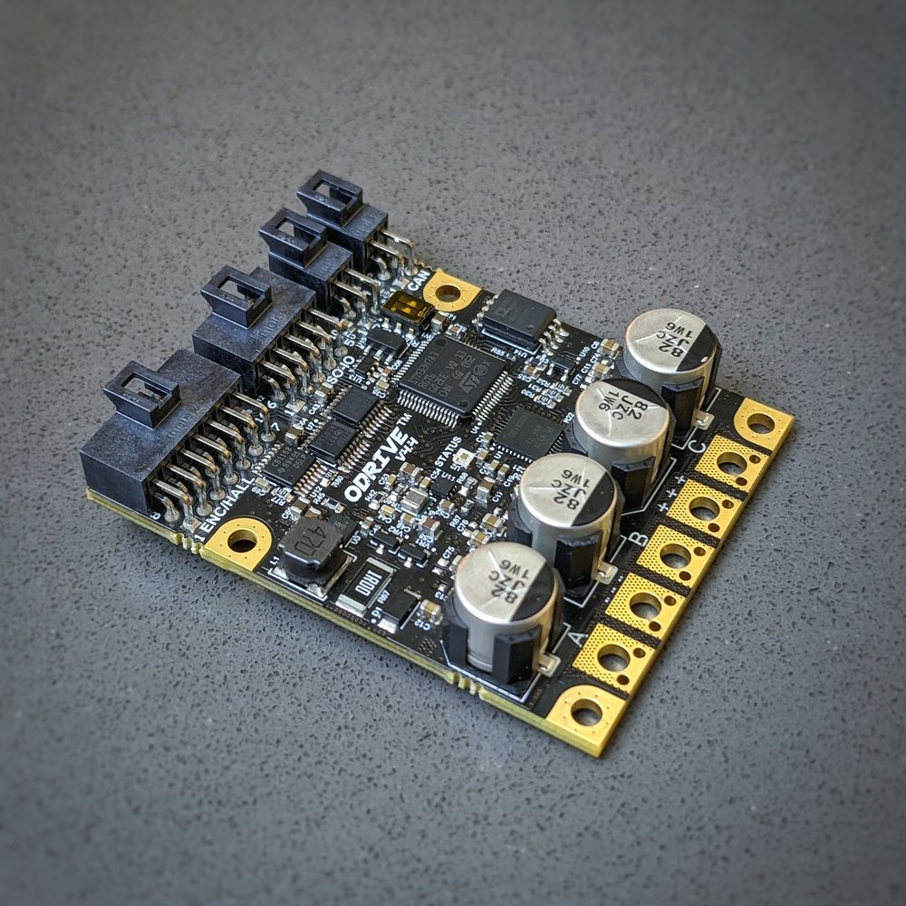
Design
Original Design
5 Odrives, 5 Servos
Current sensing via shunt resistor
ATMEGA2560 Microcontroller
IMAGE / GRAPHIC
ELECTRICAL AND COMPUTER ENGINEERING
GRAINGER ENGINEERING

Slide 9
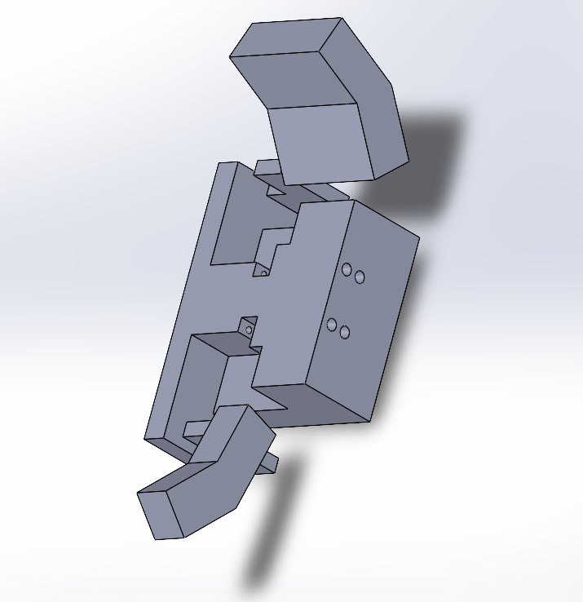
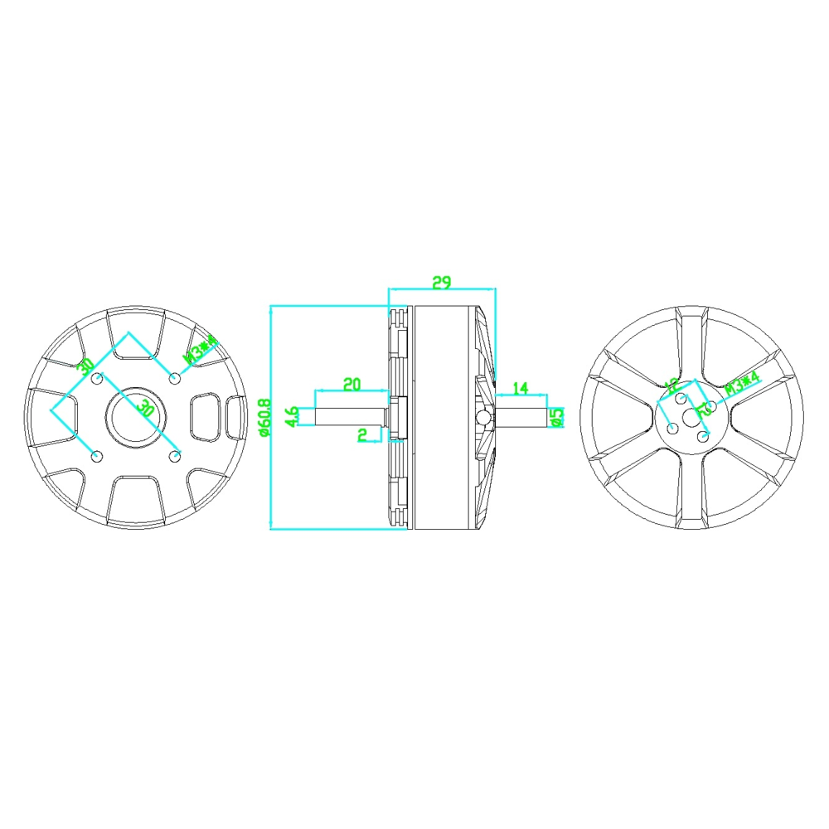
Design
Revisions
Haptic Feedback Mitten - All fingers and thumb
Costs less
Less complexity
IMAGE / GRAPHIC
ELECTRICAL AND COMPUTER ENGINEERING
GRAINGER ENGINEERING

Slide 10
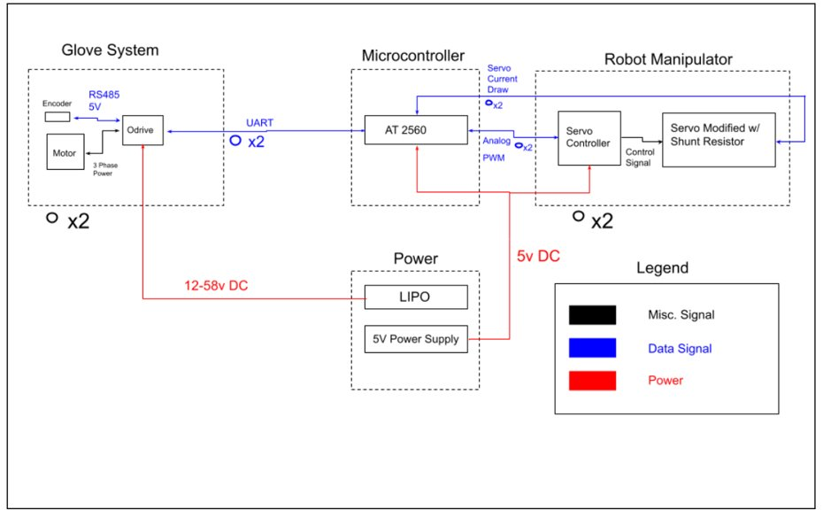
Design
Block Diagram and Requirements
4 Subsystems
Glove
Manipulator
Processing (Microcontroller)
Power
IMAGE / GRAPHIC
ELECTRICAL AND COMPUTER ENGINEERING
GRAINGER ENGINEERING

Slide 11
PCB Design
ELECTRICAL AND COMPUTER ENGINEERING
GRAINGER ENGINEERING

Slide 12
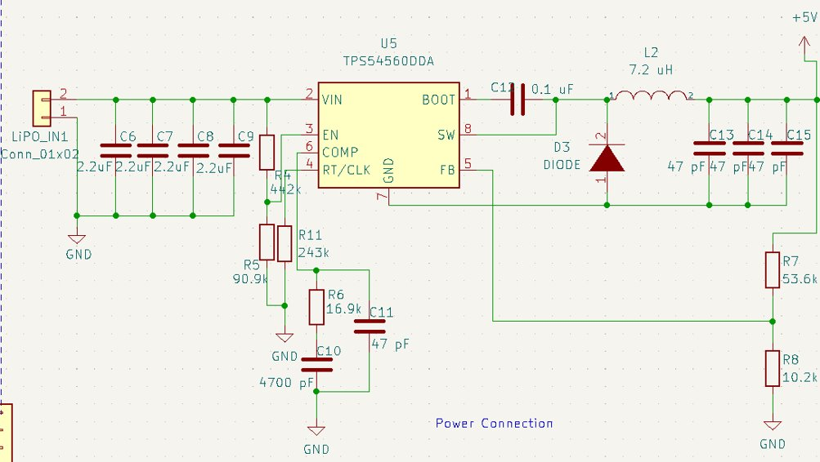
PCB
Power
5V to Microcontroller
Step down 24V to 5V
IMAGE / GRAPHI
ELECTRICAL AND COMPUTER ENGINEERING
GRAINGER ENGINEERING

Slide 13
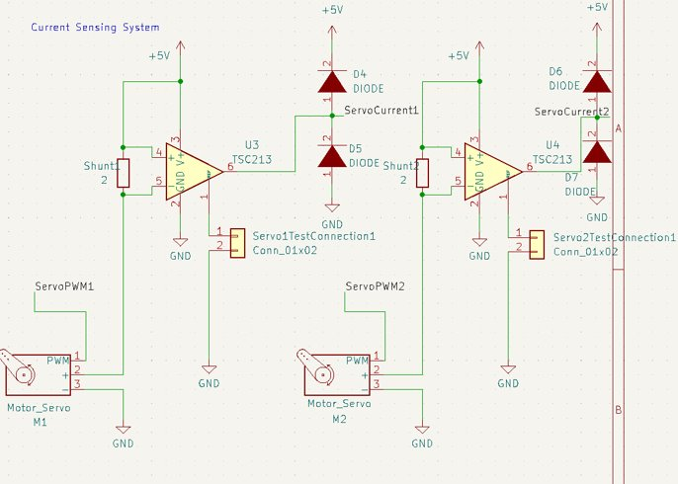
PCB
Current Sensing
Output current value to microcontroller
Enough voltage variation for ADC
IMAGE / GRAPHIC
ELECTRICAL AND COMPUTER ENGINEERING
GRAINGER ENGINEERING

Slide 14
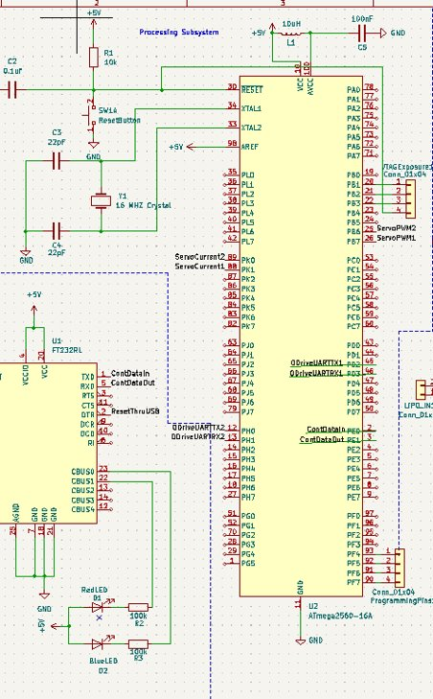
PCB
Microcontroller
Be able to control servos (PWM) and BLDC motors (UART)
Read current data from servos and communicate back to the glove
IMAGE / GRAPHIC
ELECTRICAL AND COMPUTER ENGINEERING
GRAINGER ENGINEERING

Slide 15
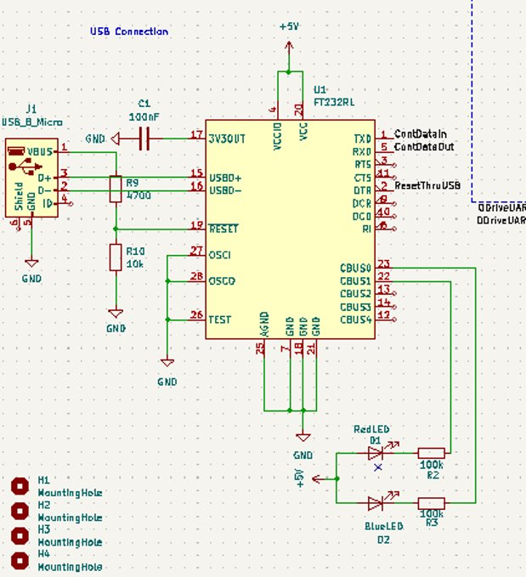
PCB
MISC
Micro USB for ease of programming
Went unused in final project
IMAGE / GRAPHIC
ELECTRICAL AND COMPUTER ENGINEERING
GRAINGER ENGINEERING

Slide 16
Results
ELECTRICAL AND COMPUTER ENGINEERING
GRAINGER ENGINEERING

Slide 17
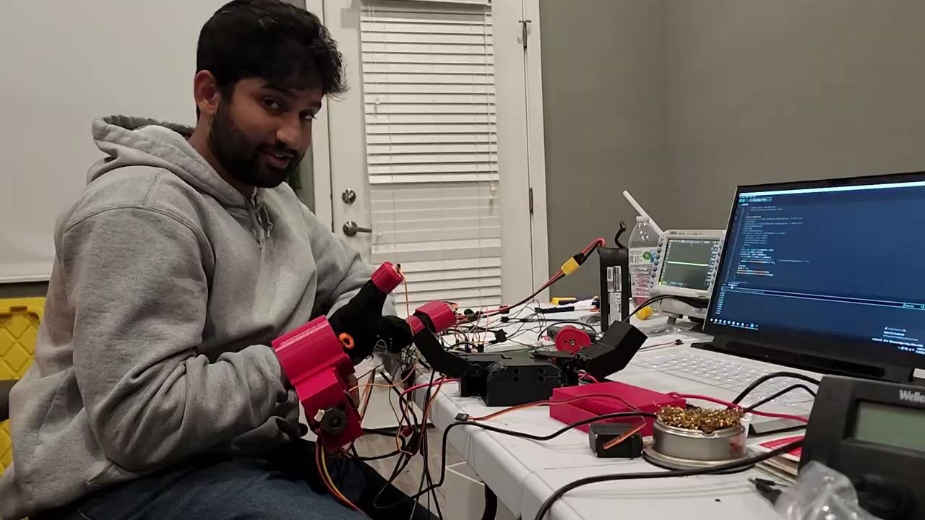
Results
CHART / GRAPH
ELECTRICAL AND COMPUTER ENGINEERING
GRAINGER ENGINEERING

Slide 18
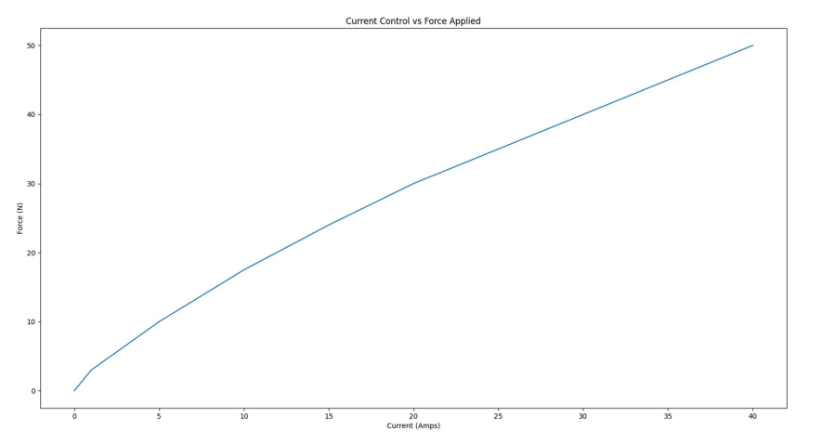
Results
CHART / GRAPH
ELECTRICAL AND COMPUTER ENGINEERING
GRAINGER ENGINEERING

Slide 19
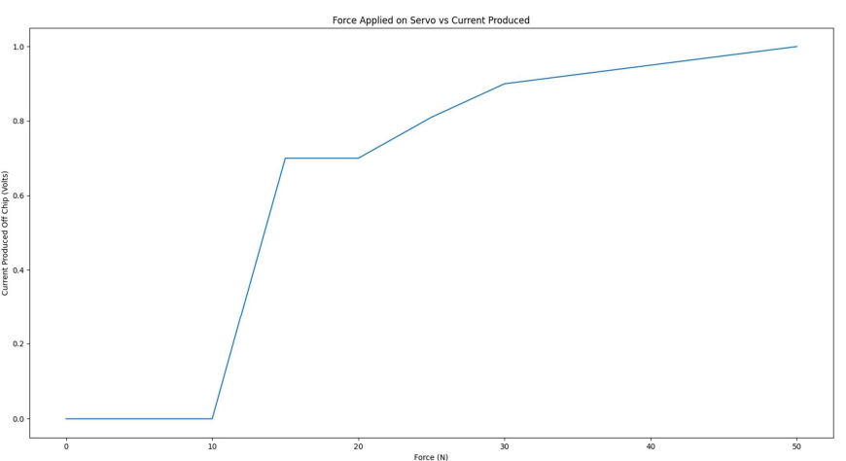
Results
CHART / GRAPH
ELECTRICAL AND COMPUTER ENGINEERING
GRAINGER ENGINEERING

Slide 20
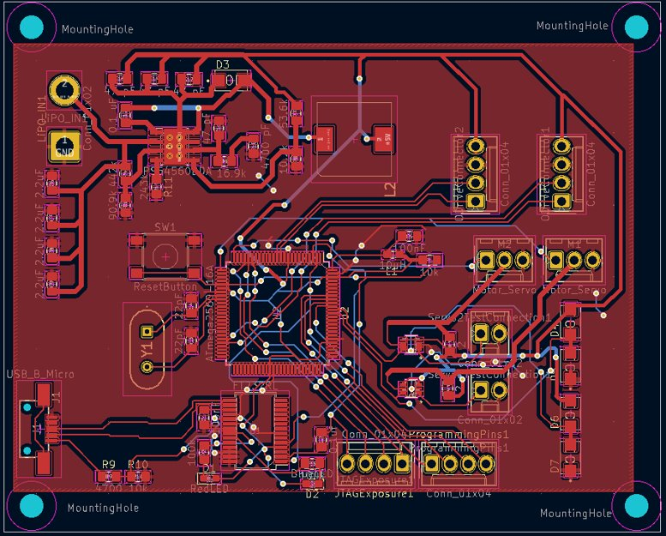
Results
What Went Well?
Fingers mimic positions
All PCB systems work
Motors can apply forces
IMAGE / GRAPHIC
ELECTRICAL AND COMPUTER ENGINEERING
GRAINGER ENGINEERING

Slide 21
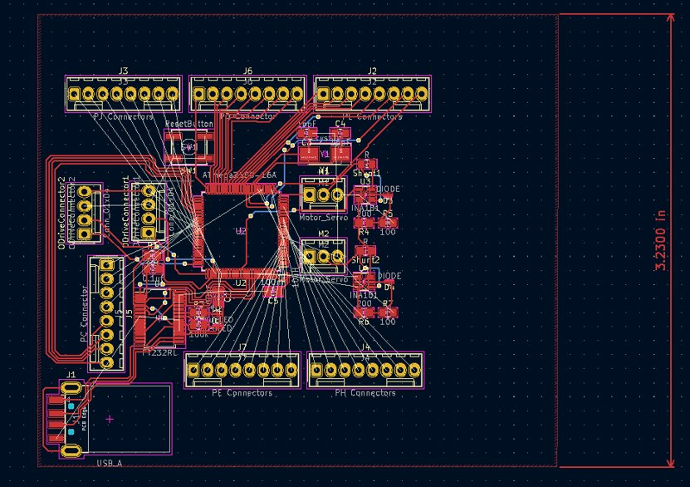
Results
What Went Wrong?
Poor buck converter design
Several PCB redesigns
Delayed, damaged and destroyed components
Noisy servo signal
IMAGE / GRAPHIC
ELECTRICAL AND COMPUTER ENGINEERING
GRAINGER ENGINEERING

Slide 22
Results
Next Steps?
Output Capacitors
Proper PCB footprints
Better servo controllers
Try not to damage components
ELECTRICAL AND COMPUTER ENGINEERING
GRAINGER ENGINEERING

Slide 23
Questions?
ELECTRICAL AND COMPUTER ENGINEERING
GRAINGER ENGINEERING

Slide 24


